Slide 1
VIOLENT CRIMES IN INDIA
FOUNDATIONS OF DATA SCIENCE PROJECT
Chemuduri Yogambika- BL.EN.U4CSE20030
Dutta Swetchana-BL.EN.U4CSE20039
Kancharla Nitish Sai- BL.EN.U4CSE20066
Karru Sushrutha- BL.EN.U4CSE20070

Slide 2
INTRODUCTION
Dataset - state wise violent crimes in 2020.
Variables include- RATE OF VIOLENT CRIMES, POVERTY RATE, LITERACY RATE, SEX RATIO etc,.
Clustering methods- K -means, Hierarchical, Affinity propagation, Gaussian Mixture

Slide 3
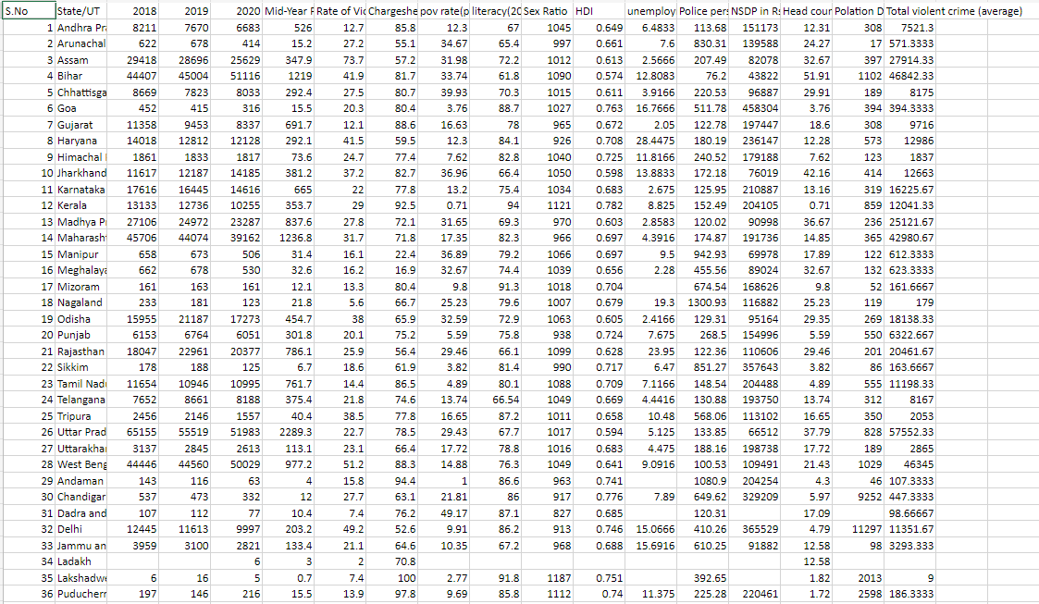
DATA SET

Slide 4
CORRELATION MATRIX
A table which displays the correlation coefficients for different variables.
The matrix depicts the correlation between all the possible pairs of values in a table.
Powerful tool to summarize a large dataset and to identify and visualize patterns in the given data.
Consists of rows and columns that show the variables. Each cell in a table contains the correlation coefficient.

Slide 5
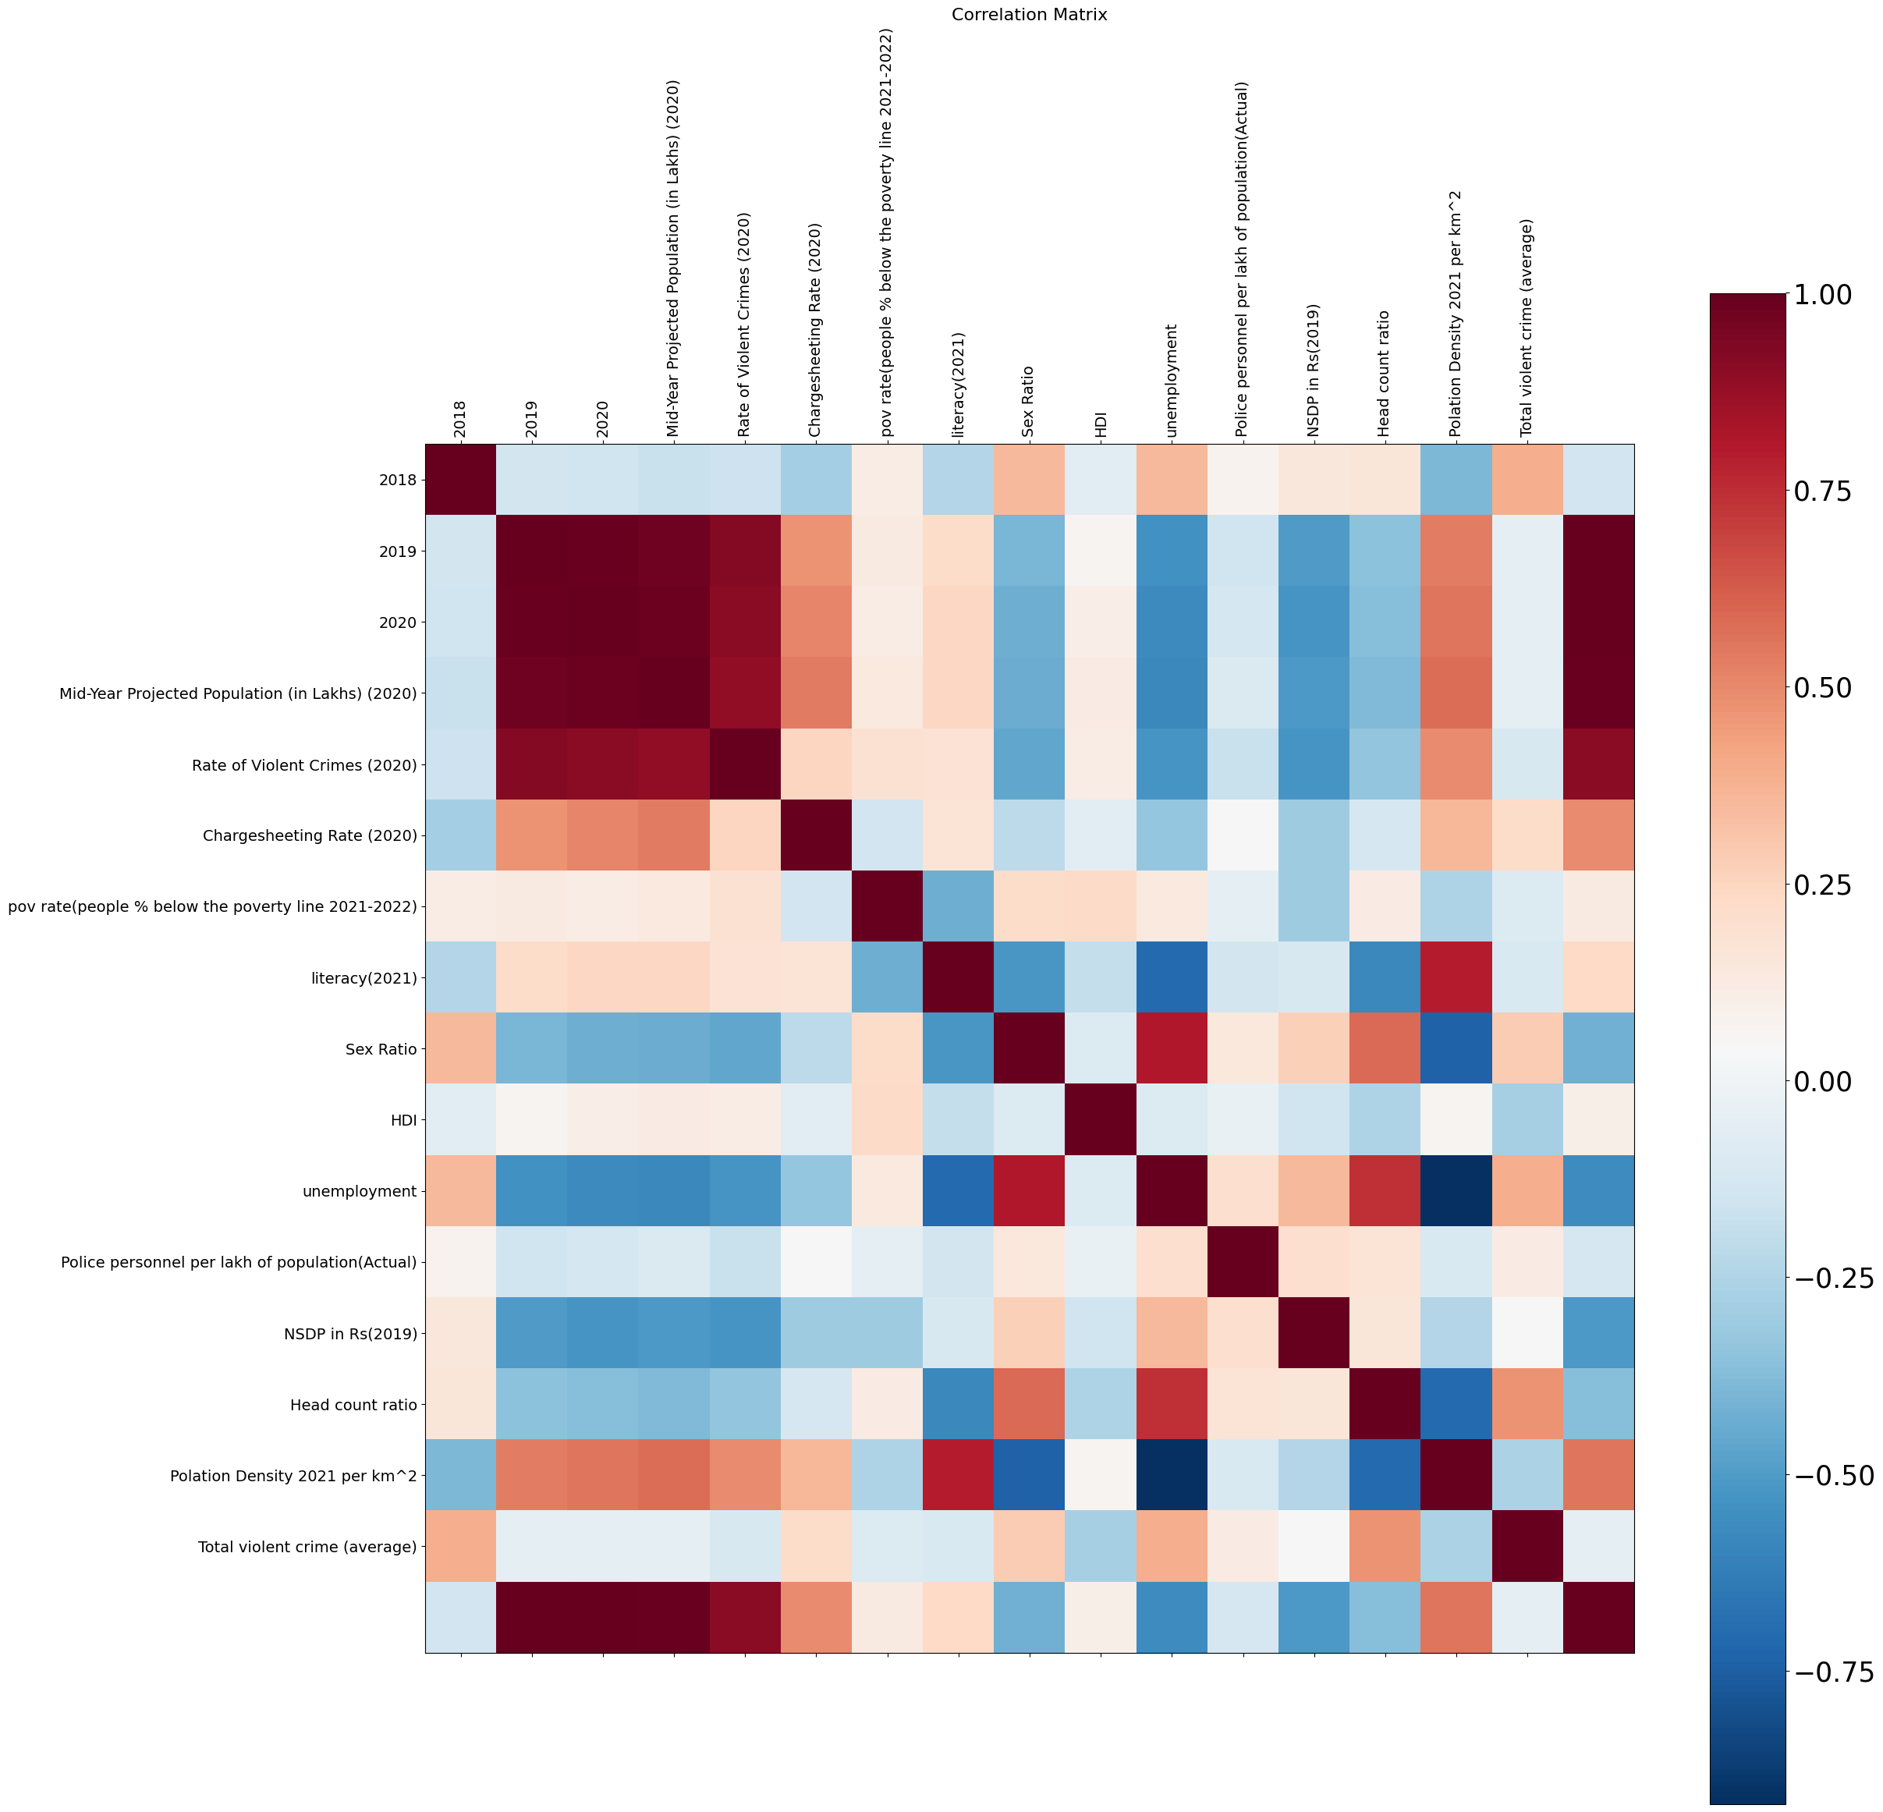
CORRELATION MATRIX

Slide 6
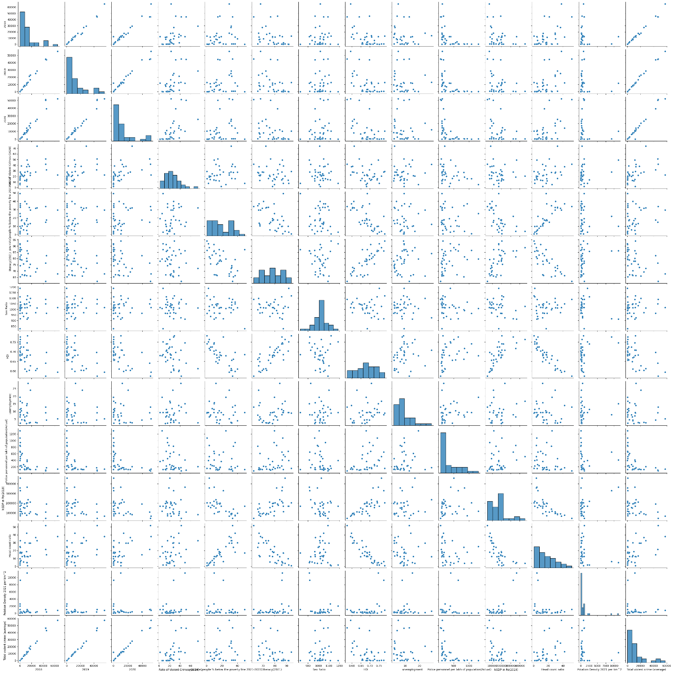
PAIR PLOT
Allows us to plot pairwise relationships between variables within a dataset.

Slide 7
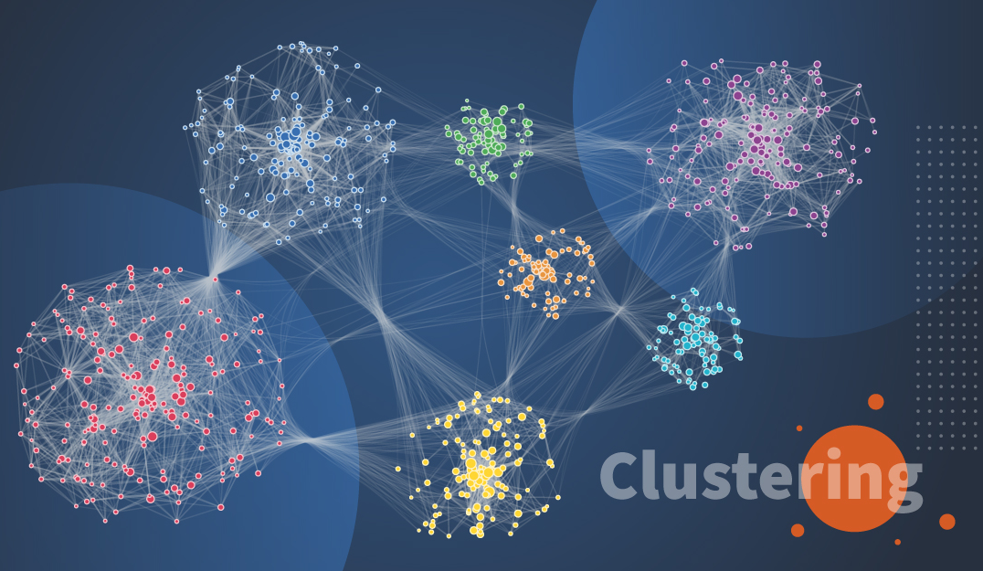
CLUSTERING
Method of partitioning a set of data or objects into a set of significant subclasses called clusters
Each of these subclasses/subsets contains data similar to each other.
Applications- data analysis, market research, pattern recognition, and image processing etc,.

Slide 8
HIERARCHICAL CLUSTERING
Hierarchy of clusters in the form of a tree, and this tree-shaped structure is known as the dendrogram.
Hierarchical clustering begins by treating every data point as a separate cluster.
Dendrogram plot, the Y-axis shows the Euclidean distances between the data points, and the x-axis shows all the data points of the given dataset.

Slide 9
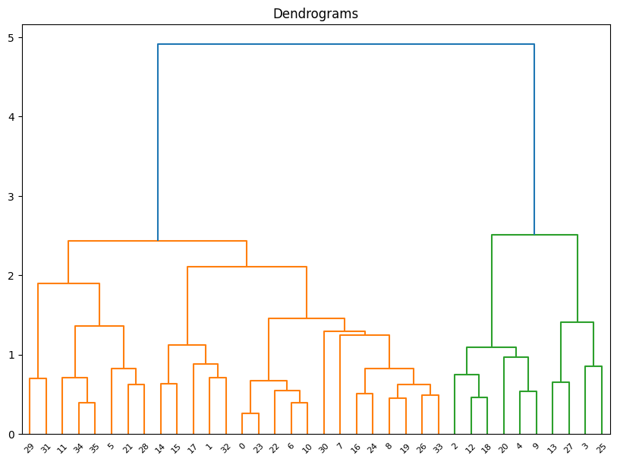
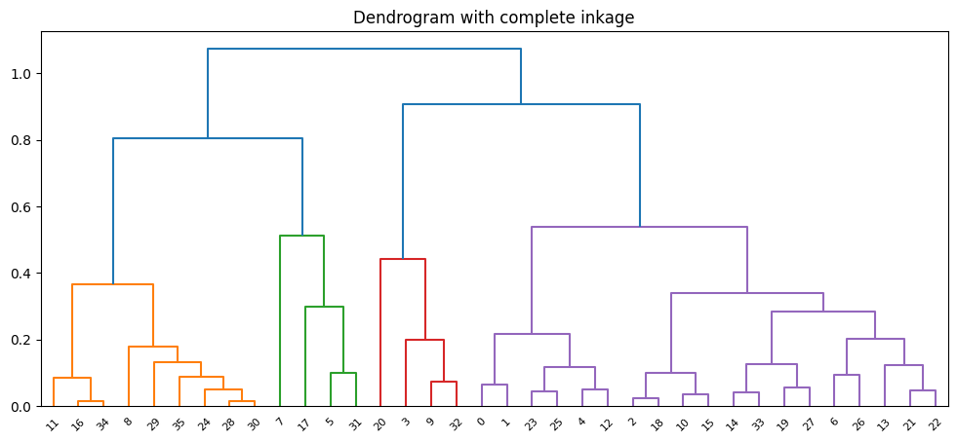
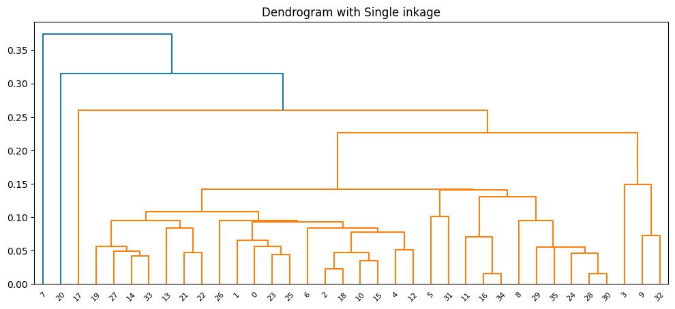

Slide 10
K MEANS CLUSTERING
Algorithm that divides the unlabeled dataset into k different clusters in such a way that each dataset belongs only one group that has similar properties.
Repeats the process until it does not find the best clusters.
Determines the best value for K center points or centroids by an iterative process.
Assigns each data point to its closest k-center. Those data points which are near to the particular k-center, create a cluster.

Slide 11
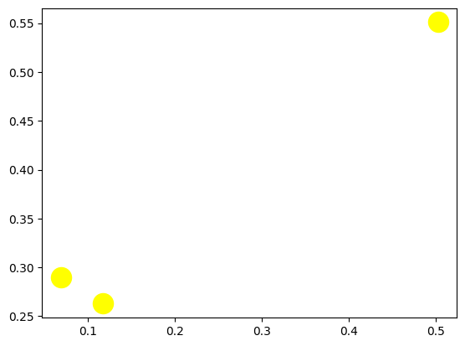
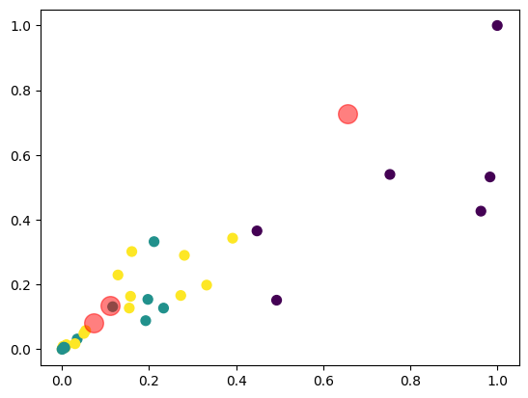

Slide 12
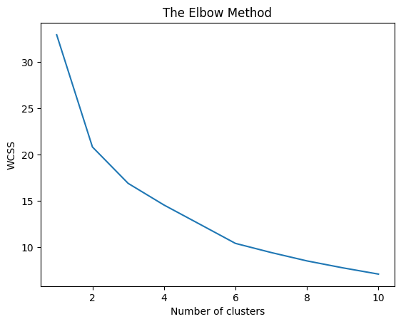
ELBOW METHOD
Used in determining the number of clusters in a data set.
The method consists of plotting the explained variation as a function of the number of clusters and picking the elbow of the curve as the number of clusters to use.

Slide 13
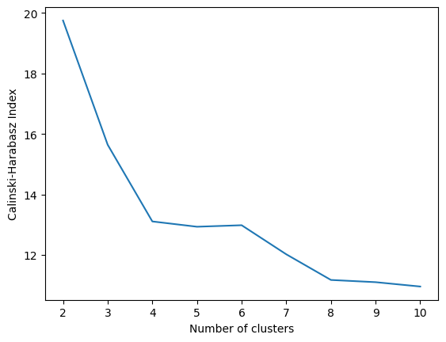
CALINSKI-HARABASZ SCORE
The Calinski - Harabasz index also known as the Variance Ratio Criterion, is the ratio of the sum of between-clusters dispersion and of inter-cluster dispersion for all clusters.
The higher the score , the better the performances.

Slide 14
FUZZY C MEANS
Fuzzy c means clustering is a Non-hierarchical clustering
It is performed by taking number of clusters as 3 and cluster center is selected and the objects which are in that range are clubbed together and formed as cluster
It is done based on fuzzy logic ie the sample is assigned to more than one class

Slide 15
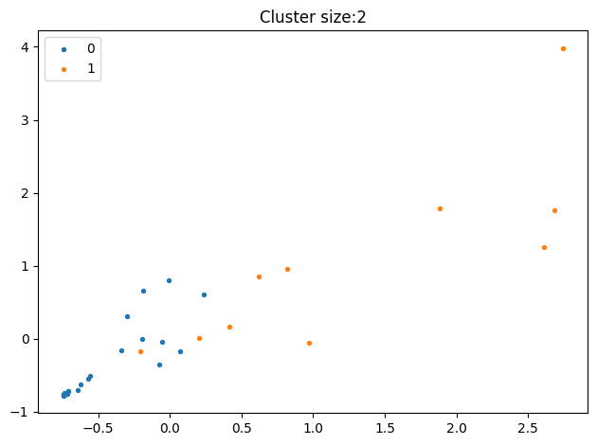
GAUSSIAN MIXTURE
Core idea - mixture of several Gaussian Distributions is applied on dataset
Gaussian mixture models can handle even very oblong clusters.

Slide 16
MEAN SHIFT CLUSERING
Assigns the data points to the clusters iteratively by shifting points towards the mode.
Also called Mode-seeking algorithm.
mean-shift does not require specifying the number of clusters in advance, the number of clusters is determined by the algorithm with respect to the data.

Slide 17
AFFINITY PROPAGATION
Affinity propagation is based on the concept of "message passing" between data points.
Affinity Propagation Clustering is a technique for sorting items according to similarity.
Unlike clustering algorithms such as k-means or k-medoids, affinity propagation does not require the number of clusters to be determined or estimated before running the algorithm

Slide 18
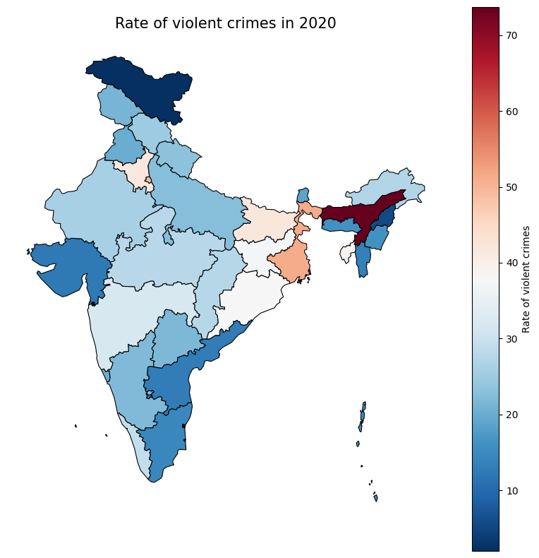
RATE OF VIOLENT CRIMES IN 2020

Slide 19
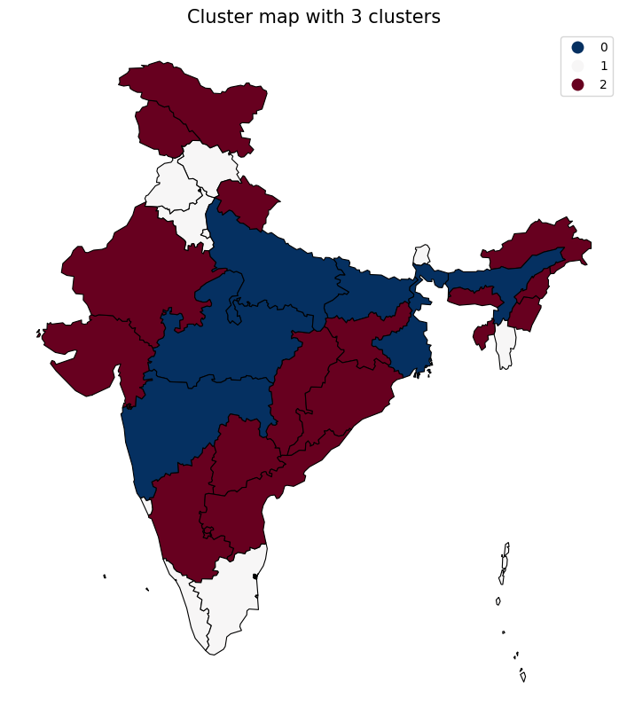
INDIA MAP WITH 3 CLUSTERS

Slide 20
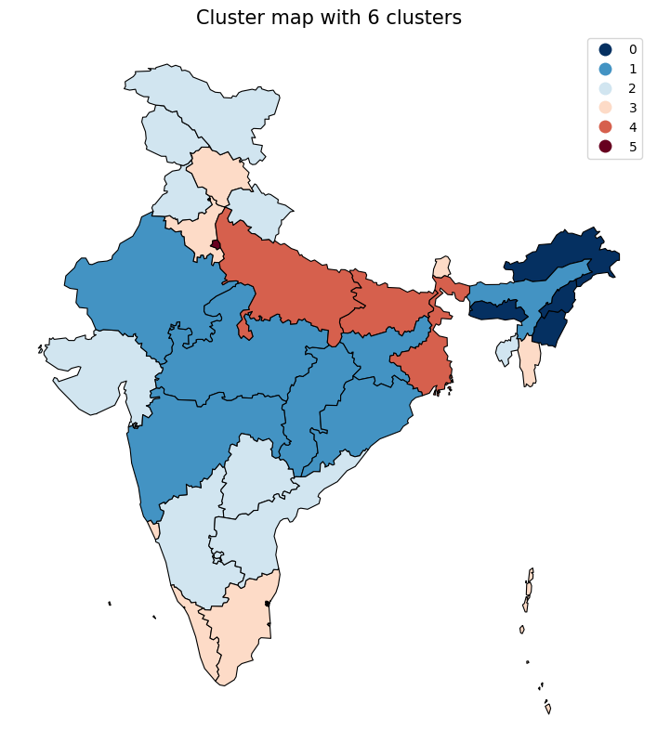
INDIA MAP WITH 6 CLUSTERS

